Slide 1
Predicting the costs of natural disasters
By Mike Stegmuller

Slide 2

Data
1980 to 2023
Cost assessments of direct losses by disaster
Number of deaths
Inflation Rate

Slide 3
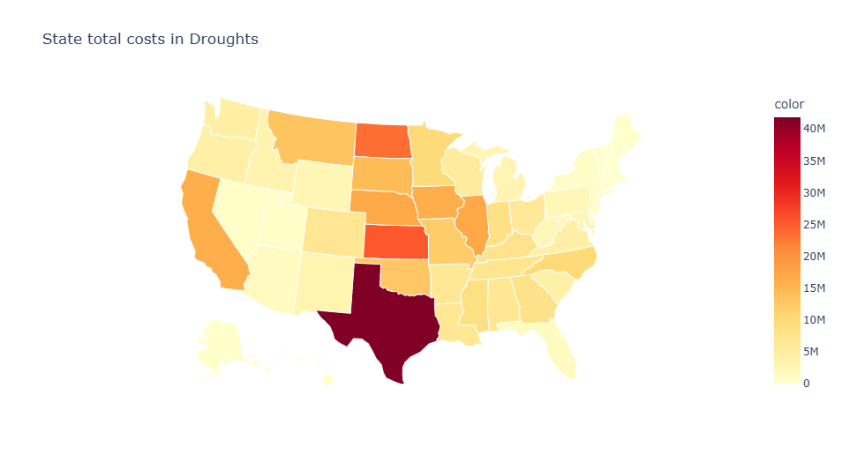

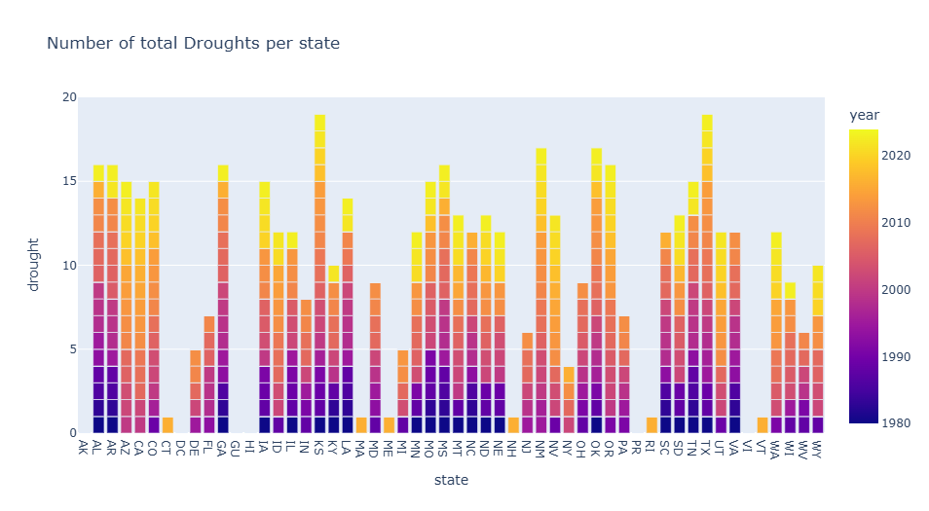
Drought
- Second most costly
Last the most number of days
Affect Great Plains

Slide 4

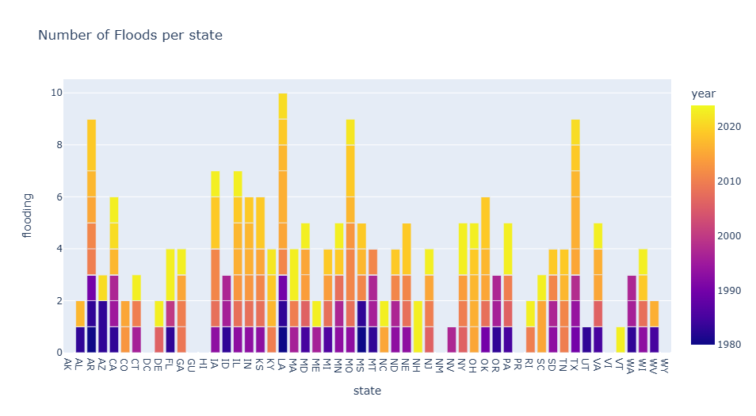
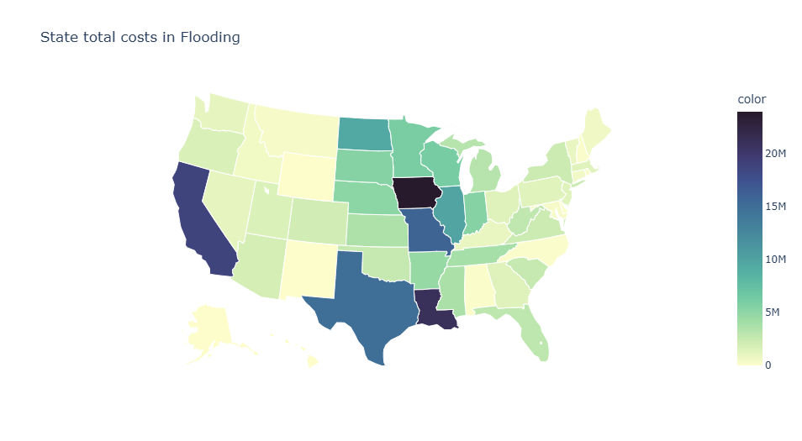
Flooding
Less than 30 major floods per year
- Affect Mississippi river basin most

Slide 5
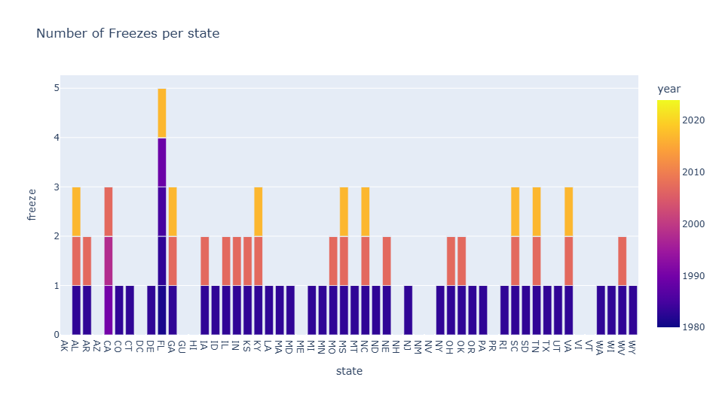

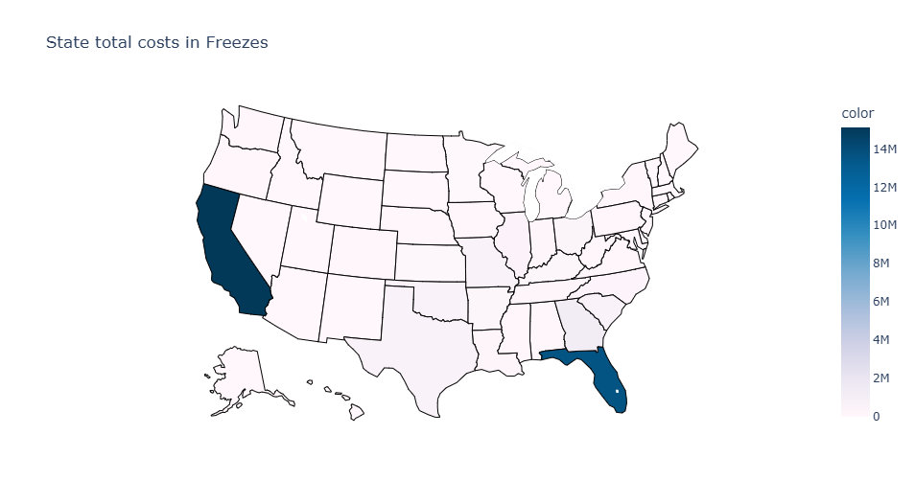
Freeze
Least amount of damage
Unlikely States

Slide 6
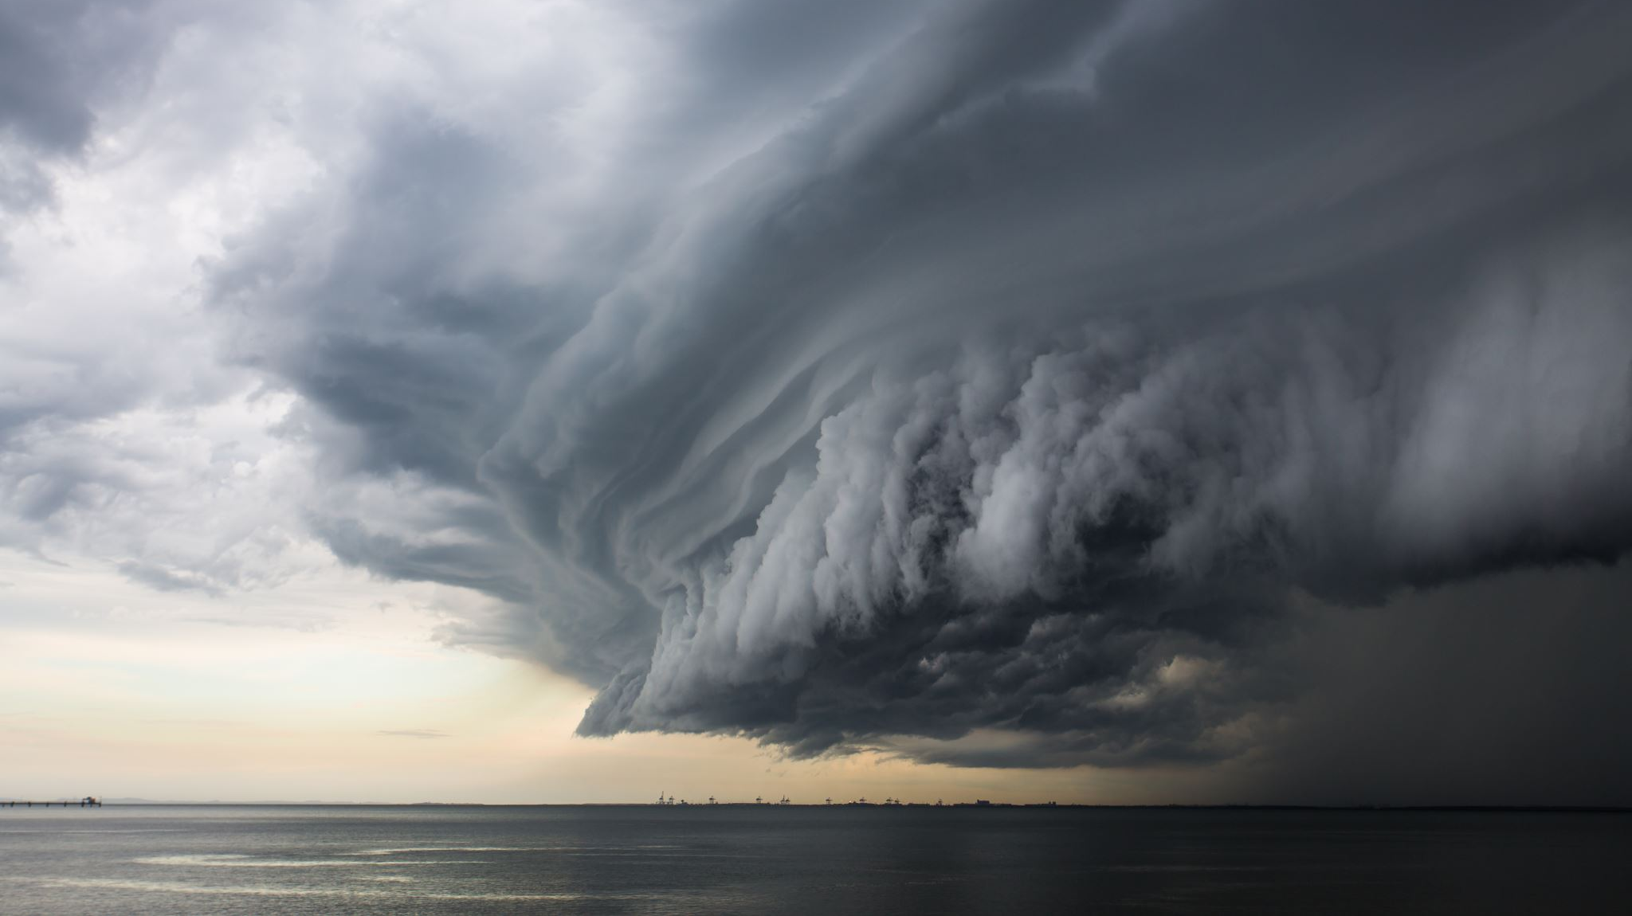
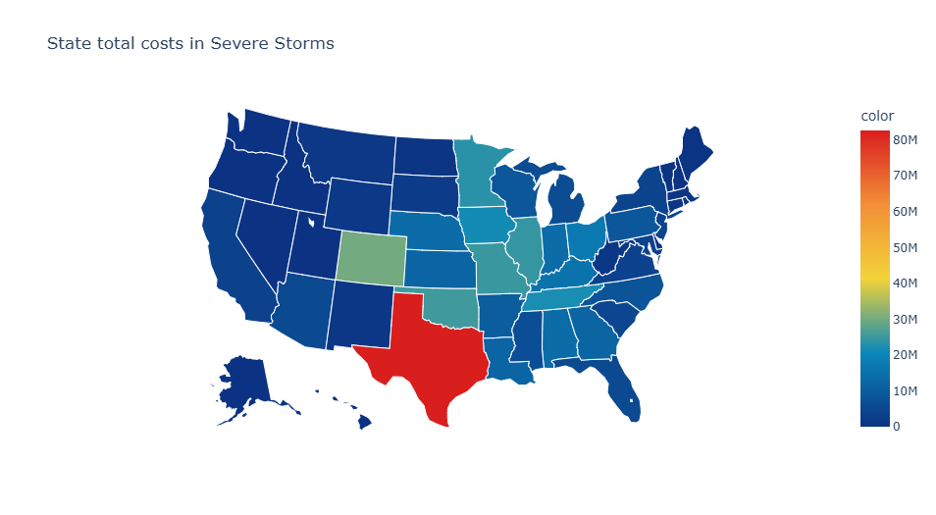
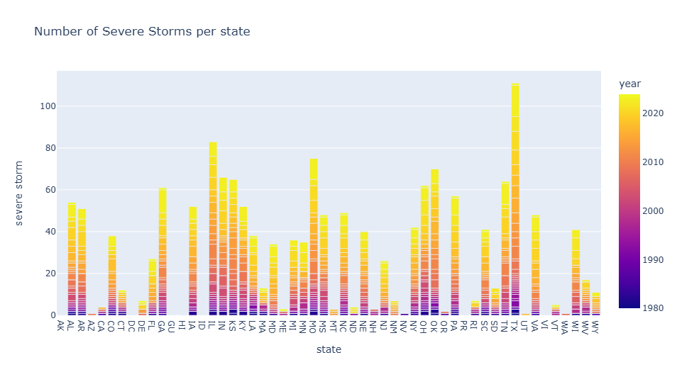
Severe Storm
severe local storms (i.e., tornado, hail, straight-line wind damage)
Cost the most amount of damage
Occur the most

Slide 7
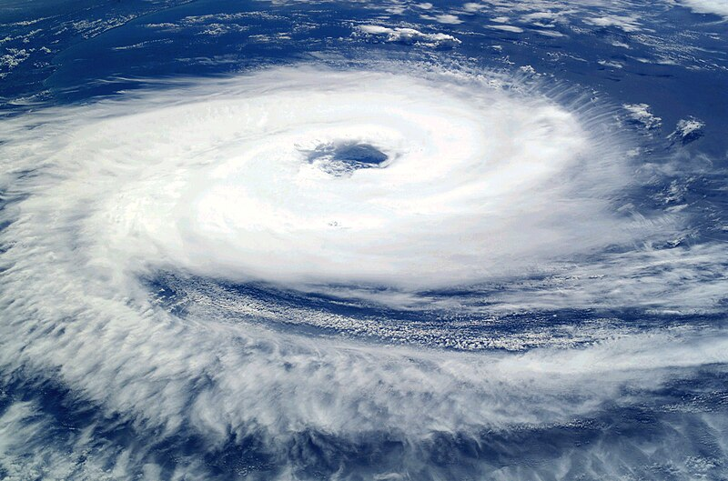
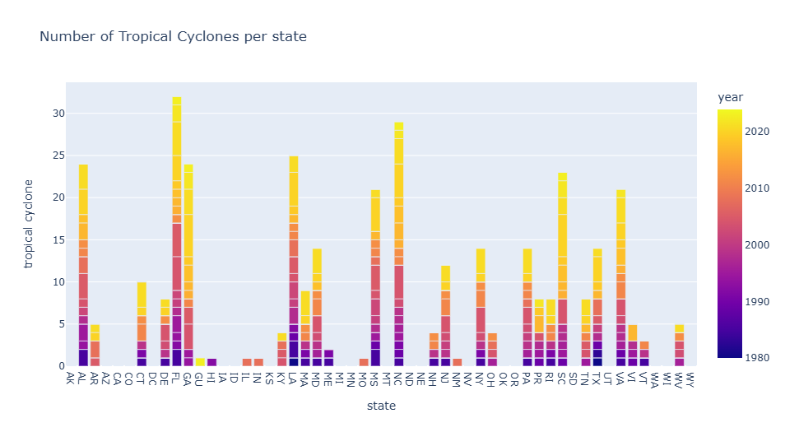
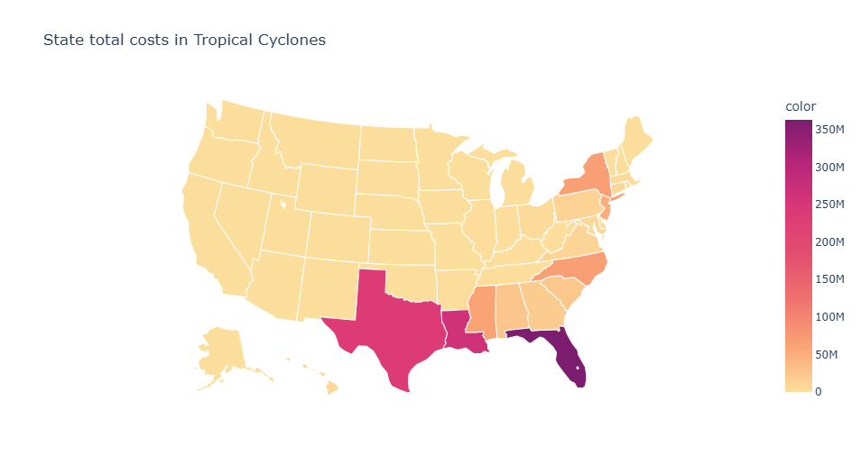
Tropical Cyclone
Cost most amount of damage per event and deaths
Affect Atlantic and Gulf States

Slide 8
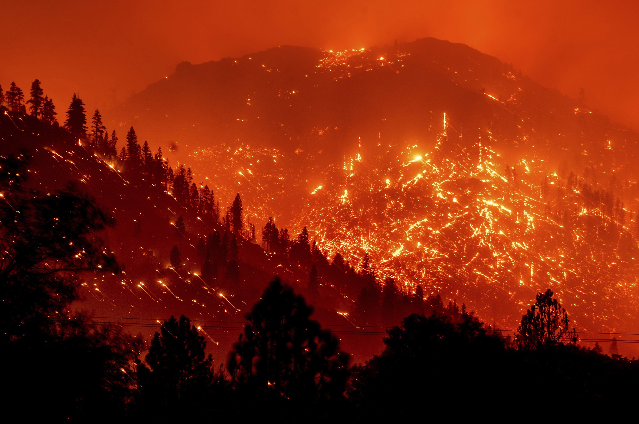
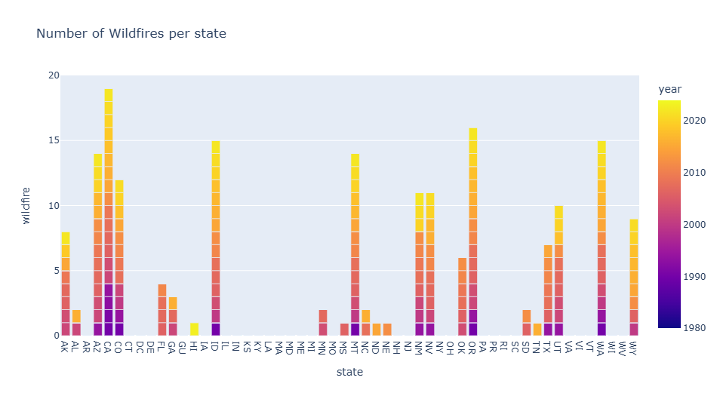
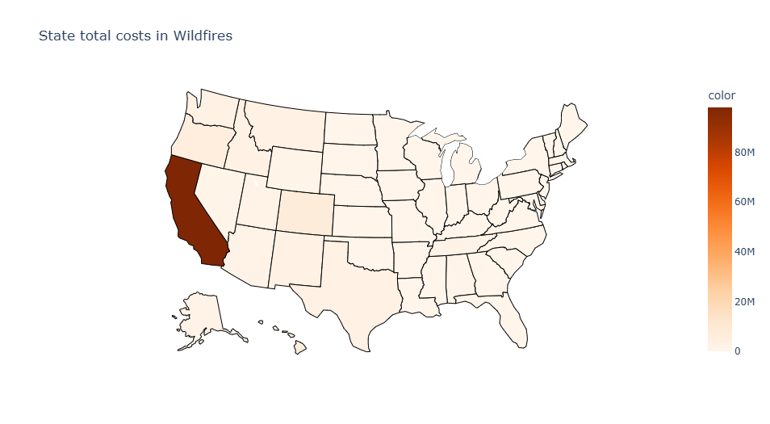
Wildfire
Occur least often
Disproportionally affects California

Slide 9

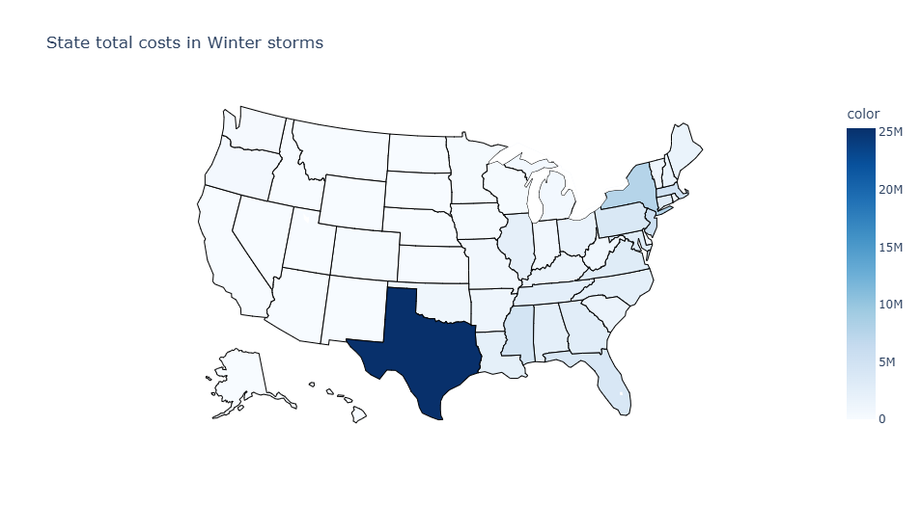
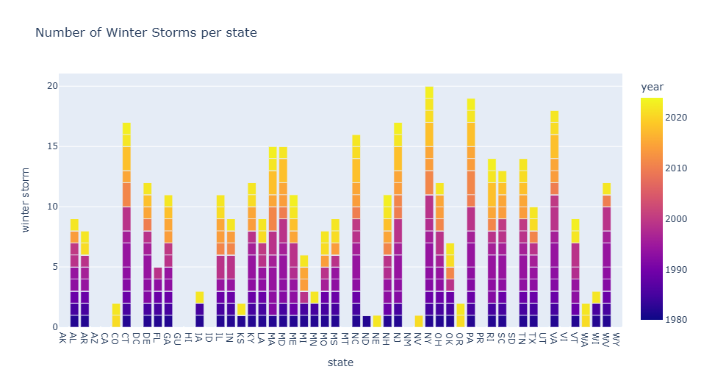
Winter Storm
F-- Affect Eastern Half of US
- Population and lack of preparation could be a major factor

Slide 10
Analysis
Disaster Type
Deaths
Number of Days
Inflation Rate

Slide 11
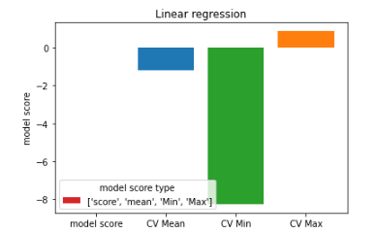
Linear Regression Model
Low, negative test score
Low training scores

Slide 12
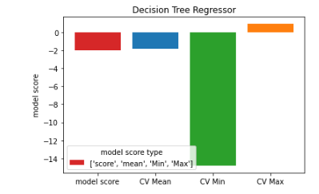
Decision Tree
Low, negative test scores
Train score is lowest of the 3 models

Slide 13
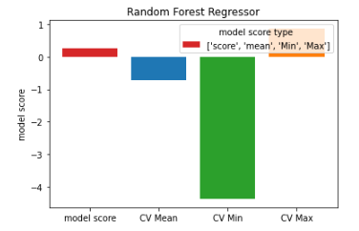
Random Forest Regressor
Positive, but low test score
High train score

Slide 14
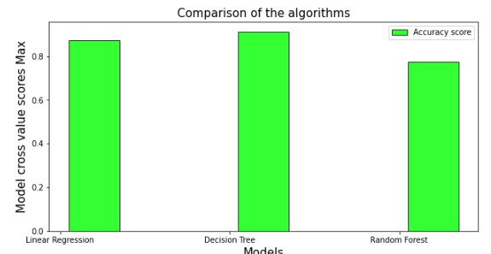
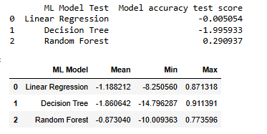
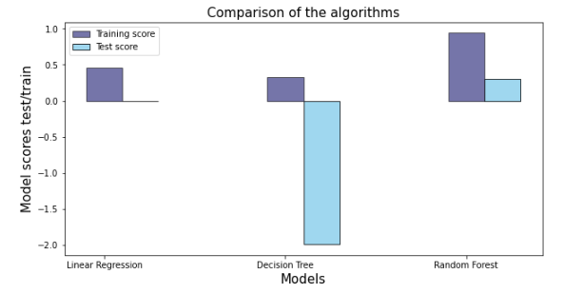
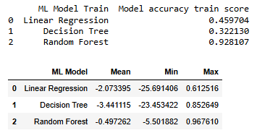
Results

Slide 15
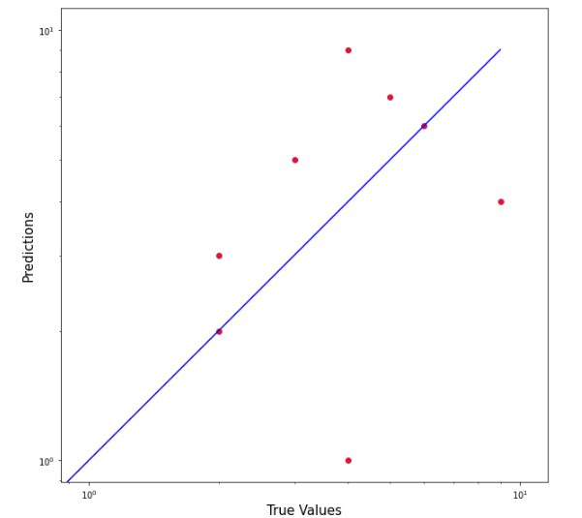
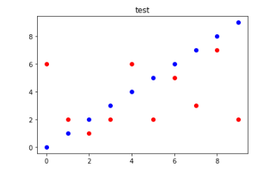
Takeaways
This shows that the predictive power is low, needs more factors

Slide 16
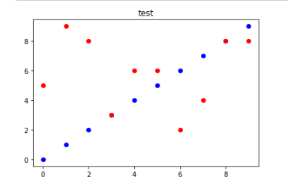
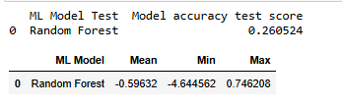
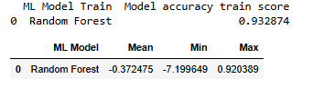
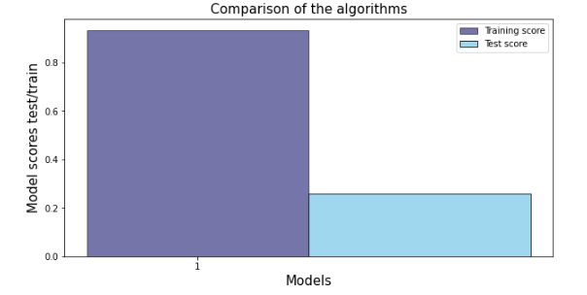
Testing Prediction
Added population to features
Not much changed

Slide 17

Future Data Improvements
Add infrastructure damage type to the information as well as how much it costs.

Slide 18
Recommendations for future Research
Rebuild Infrastructure more resistant to damage
Research what can prevent deaths
Research patterns in weather

